Slide 1
Mess Registration Reminder System
Tarun 2020102056
IIIT Hyderabad
Notes:
fsgjhgf

Slide 2
Problem statement
Harness your creativity to craft a unique product by leveraging the
capabilities of Plivo APIs.

Slide 3
Introduction
In this project, I've addressed the common issue of students forgetting their mess registrations in a college with multiple dining options. I've created a portal for students to easily select their breakfast, lunch, snacks, and dinner preferences. The system sends timely reminders 30 minutes before mealtime, including mess details and the menu.
Additionally, there's a morning alert for students who haven't chosen a mess, ensuring no one misses meals. I've also provided a client-side interface for mess administrators to send important messages, such as delays or special menu items.

Slide 4
Potential Impact of the Solution
Minimized Meal Skipping:
Streamlined Meal Management:
Targeted Communication:
Efficient Meal Alternatives:

Slide 5
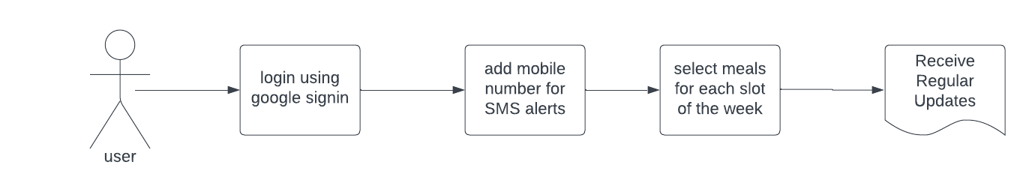
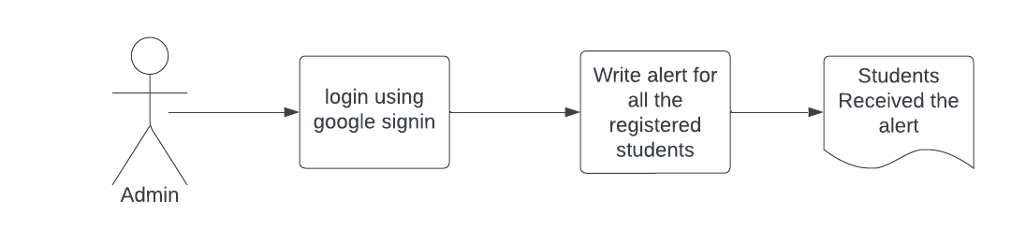
Flow Diagram

Slide 6
Prototype and Demo

Slide 7
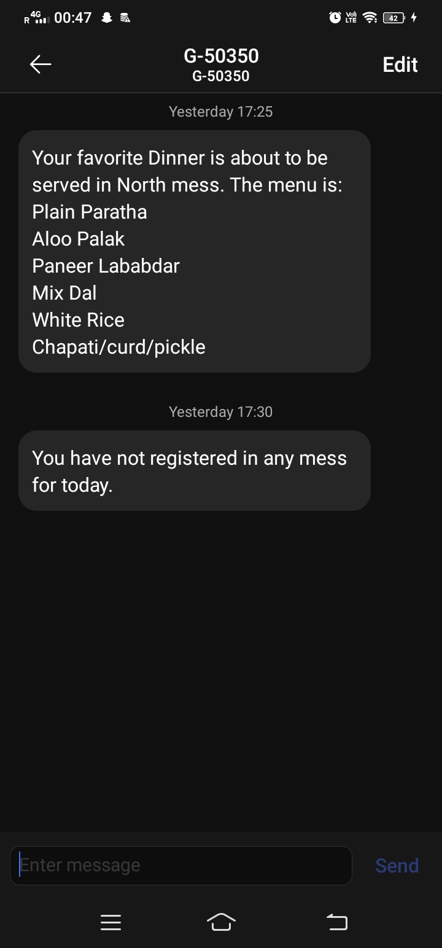
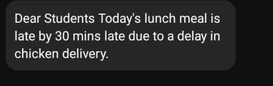
Sample Messages

Slide 8
Challenges Faced
Choosing the Database.
Testing the functionality as the SMS were scheduled for a fixed timings.

Slide 9
Potential Future Features
Admin Portal Enhancements:
Allow admins to send images of special dishes in today's menu.
Parental SMS Alerts (For School Messes):
Introduce an option for admins to send SMS alerts to parents if a student misses a meal.
Reminder by Call:
Add a calling feature for students who prefer to receive meal reminders via phone call.
Student Feedback Feature:
Implement a feature for students to send a return message if they don't wish to avail the meal.

Slide 10
Thanks

